Slide 1
Module-VI
ASP.NET MVC

Slide 2
Model-View-Controller
1) Model
The model component stores data and its related logic. It represents data that is being transferred between controller components or any other related business logic. For example, a Controller object will retrieve the customer info from the database. It manipulates data and send back to the database or use it to render the same data.
It responds to the request from the views and also responds to instructions from the controller to update itself. It is also the lowest level of the pattern which is responsible for maintaining data.
2) View
A View is that part of the application that represents the presentation of data.
Views are created by the data collected from the model data. A view requests the model to give information so that it resents the output presentation to the user.
The view also represents the data from chats, diagrams, and table. For example, any customer view will include all the UI components like text boxes, drop downs, etc.

Slide 3
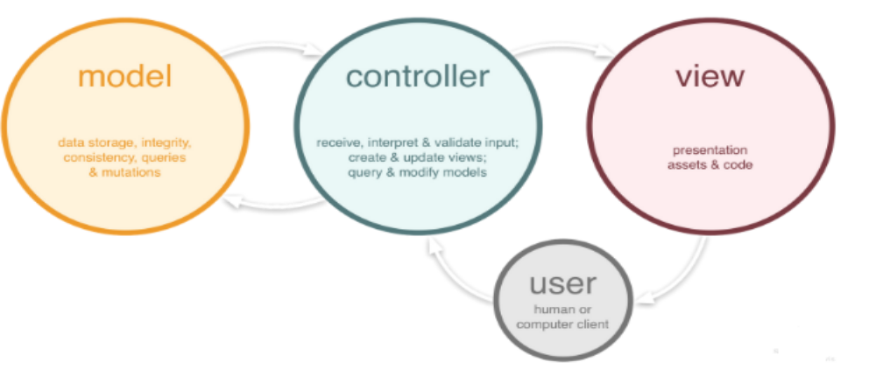
3) Controller
The Controller is that part of the application that handles the user interaction.
A Controller send's commands to the model to update its state(E.g., Saving a specific document). The controller also sends commands to its associated view to change the view's presentation (For example scrolling a particular document).

Slide 4
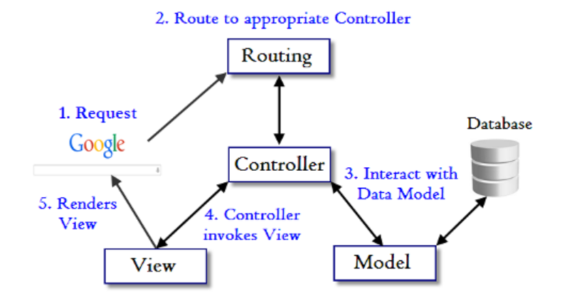
ASP.NET MVC
MVC Pattern
Normally a user interacts with the view and performs some action on the screen. A request is generated from the view which is handled by the controller. Controller is actually responsible for handling http request. Suppose our application has been hosted on ‘localhost’ domain and when we send the request to
http://localhost:53456/students
a controller will be selected to handle this request. This controller will get all the students from the database and put them into the view and return the view to the client into the browser.
We’ve already discussed that when the request comes in then controller handles the request. But there are multiple controllers in the application and it is the responsibility of the Router to match the requested URL from their routes and request a right controller to handle that request.

Slide 5
HTML helper Methods
HTML Element | Example
TextBox | @Html.TextBox("Textbox1", "val") Output: <input id="Textbox1" name="Textbox1" type="text" value="val" />
CheckBox | @Html.CheckBox("Checkbox1", false) Output: <input id="Checkbox1" name="Checkbox1" type="checkbox" value="true" /> <input name="myCheckbox" type="hidden" value="false" />
RadioButton | @Html.RadioButton("Radiobutton1", "val", true) Output: <input checked="checked" id="Radiobutton1" name="Radiobutton1" type="radio" value="val" />
TextArea | @Html.TextArea("Textarea1", "val", 5, 15, null) Output: <textarea cols="15" id="Textarea1" name="Textarea1" rows="5">val</textarea>
Drop-down list | @Html.DropDownList (“DropDownList1”, new SelectList(new [] {"Male", "Female"})) Output: <select id="DropDownList1" name="DropDownList1"> <option>M</option> <option>F</option> </select>

